Slide 1
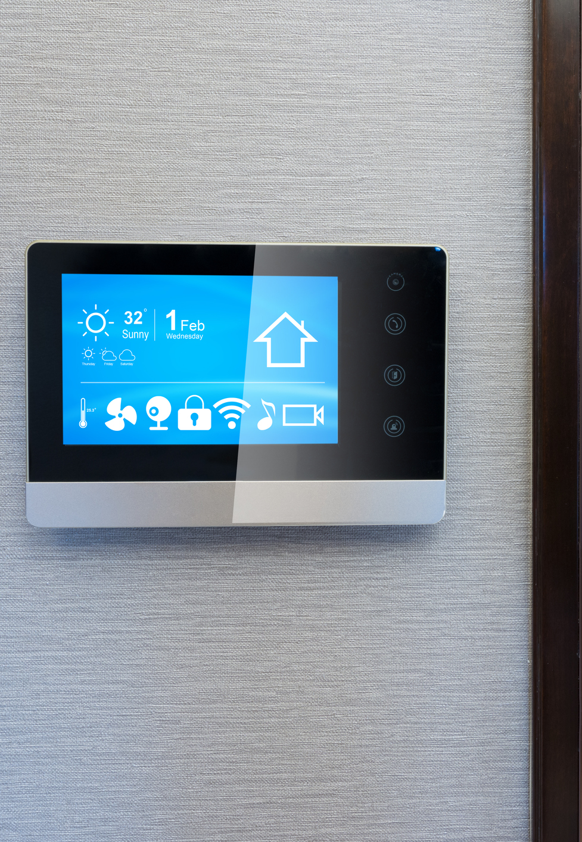
Connected Thermostats
Improve occupant comfort and manage energy use and costs.
Simple to program
Options for set-back temperatures in multiple areas
Wireless controls
Automatic updates and alerts
Incentives for qualifying installation and for programming verification.

