Slide 1
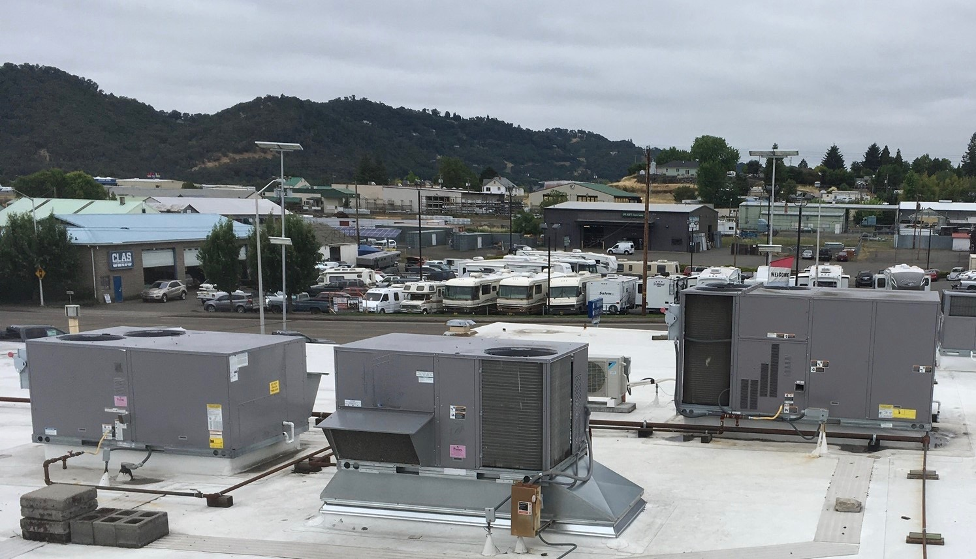
Advanced Rooftop Unit Controls
Increase energy savings
Extend equipment life
Reduce maintenance
Improve indoor air quality
Improve occupant comfort
Employ remote control and monitoring
Earn incentives for qualifying retrofits

